Slide 1
How to read an ECG
Dr T A DIALLO Cardiologist EFSTH

Slide 2
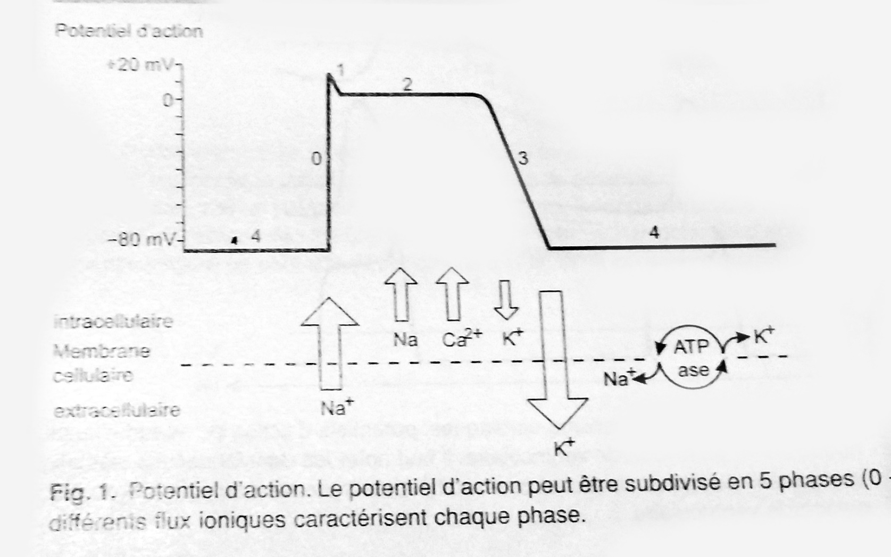
Physiology 1

Slide 3
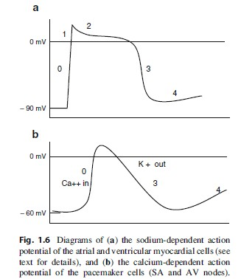
Physio 2

Slide 4
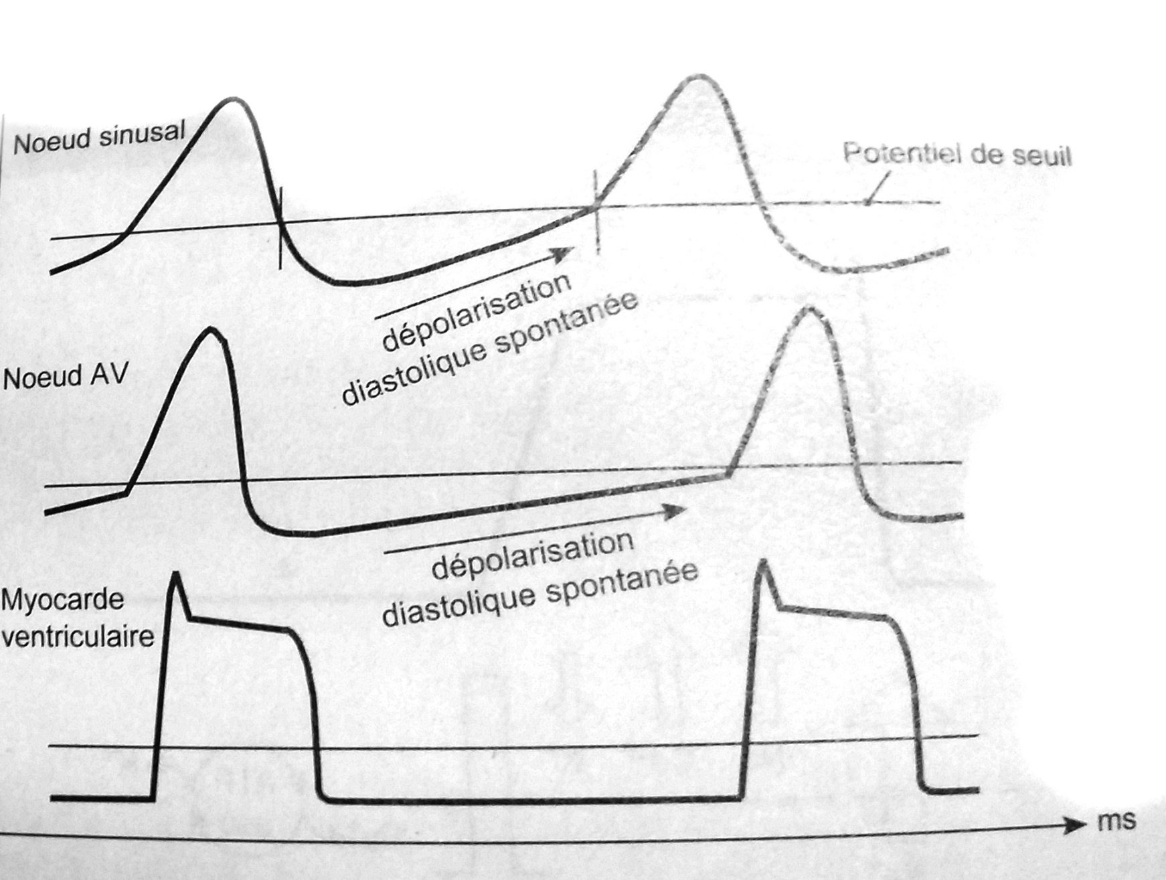
Physio –Spontaneous depolarization

Slide 5
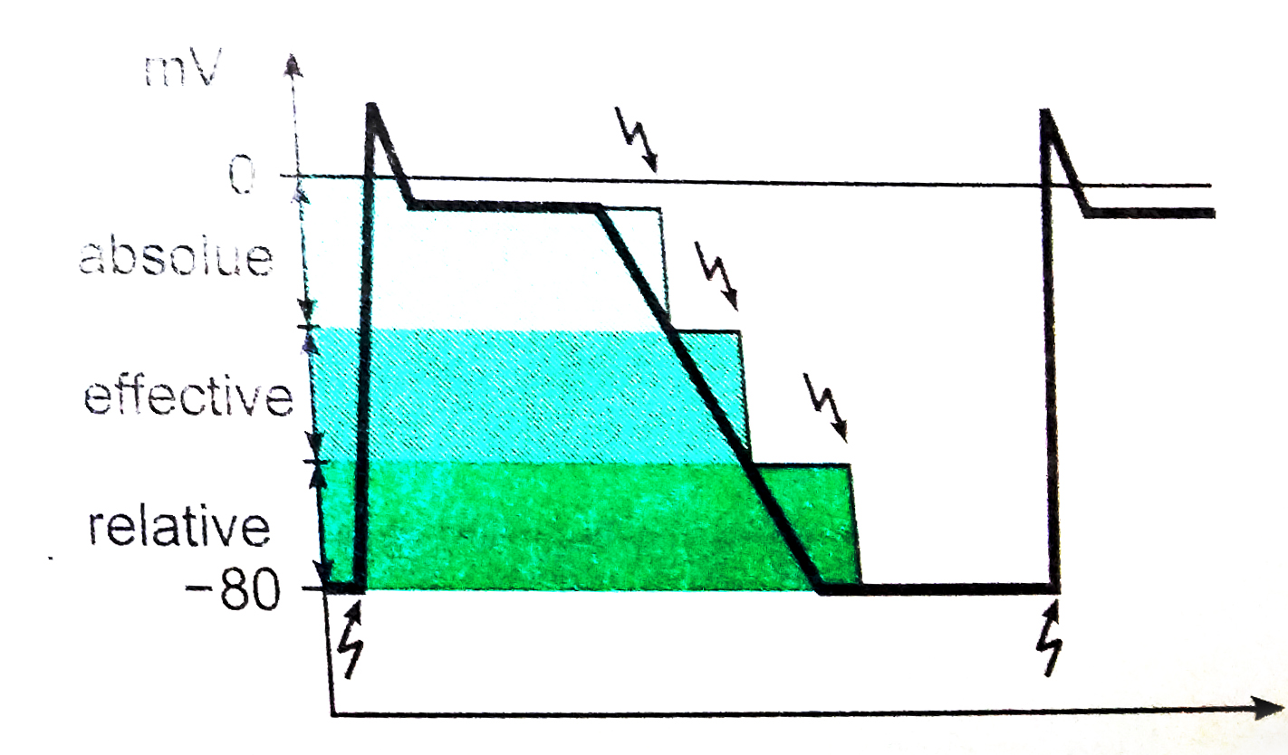
Refractory period

Slide 6
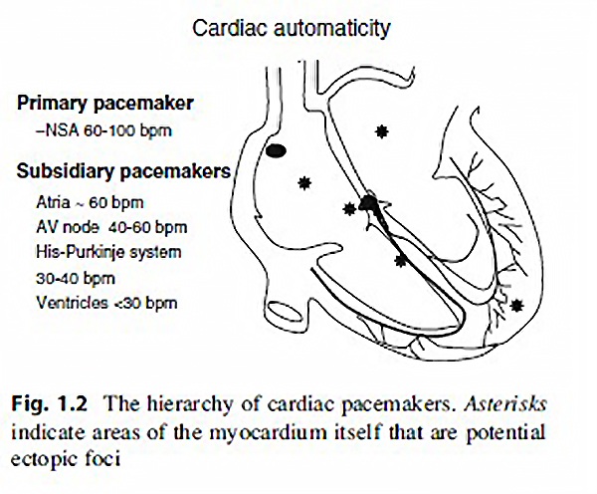
Cardiac automaticity

Slide 7
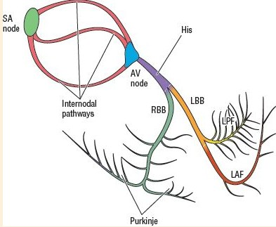
Nervous system

Slide 8
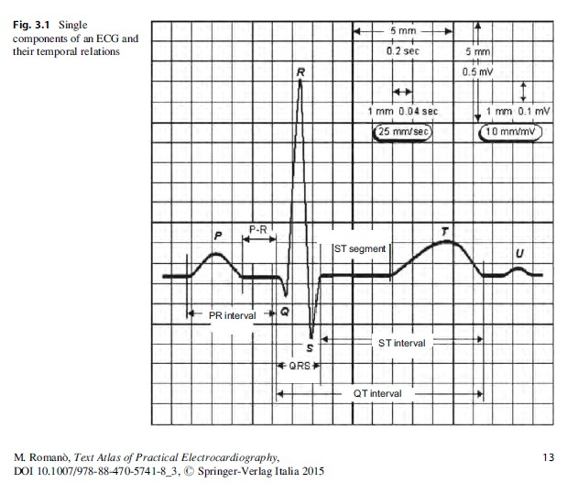
Components of an ECG

Slide 9
ECG Normal values
Cardiac frequency 60-100/mn
P wave : wide: <100ms Height <2.5ms Positive, frequently negative on aVr and V1
PR space: 120-200ms Isoelectric level
QRS complex: <80ms small r big S in V1, big R small s in V6
QRS axis: between 0 and +90 degrees
ST segment: Isoelectric level
T wave: Asymetric, round summit, harsh sloping
negative in aVR, variable in DIII, aVF, V1
QT: Variable in function of cardiac frequency

Slide 10
Interpretation in practice
Check the calibration, usually 1mv/10mm amplitude, and the paper speed 25mm/s
1 Determine rhythm (sinus?) and Cardiac frequency
2 Analyse in the order waves and segments:
P wave
PR space, from the start of P to the start of QRS
Morphology and QRS complex duration
QRS axis , Q wave <1/3 of corresponding R , duration <40ms
ST segment (End of QRS to the start of T wave)
T morphology
QT interval (start QRS - end of T) normal <440ms at 60 bpm
.Make a synthesis of abnormalities found
.Propose an interpretation

Slide 11
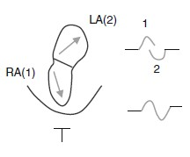
The P Wave
The P wave is the graphic representation of atrial electrical activation. It normally has a duration of 50–120 ms and a maximum amplitude of 2.5 millimeters (generally recorded in lead II).
Atrial depolarization normally proceeds downward from the SA node and from right to left. The mean electrical axis in the frontal plane thus ranges from +10d to +90d. The P wave is positive in the inferior leads, negative in lead aVR, and positive in all the precordial leads except V1, where it is biphasic (positive, then negative).
Deviations from these norms are suggestive of an ectopic atrial rhythm.
The P wave includes two components: the first corresponds to the activation of the right atrium, the second to that of the left atrium.

Slide 12
The PR Interval
The PR interval represents the time needed for atrioventricular conduction. It is measured from the beginning of atrial activation to the beginning of ventricular activation, and its normal durationis from 120 to 200 ms

Slide 13
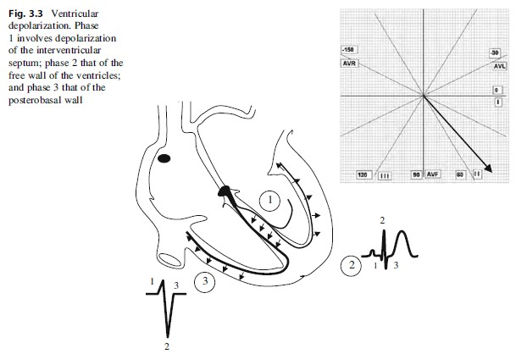
The QRS Complex
The QRS complex represents ventricular depolarization, which begins in the interventricular septum, proceeding from the endocardium to the epicardium and from left to right.
It then extends to the free anterior walls and finally the posterobasal regions of the two ventricles
The main direction of the depolarization wavefront is from top to bottom and from right to left in the frontal plane and from back to front and from right to left in the horizontal plane.
In the frontal plane, the electrical axis of the QRS complex generally ranges from 10d to +80d
The normal QRS complex has a duration of 60–100 ms. The Q wave is the first negative deflection after the P wave, the R wave is the first positive deflection, and S wave is the first negative deflection after the R wave.
A second positive deflection sometimes follows the S waveand is indicated by the letter R’

Slide 14
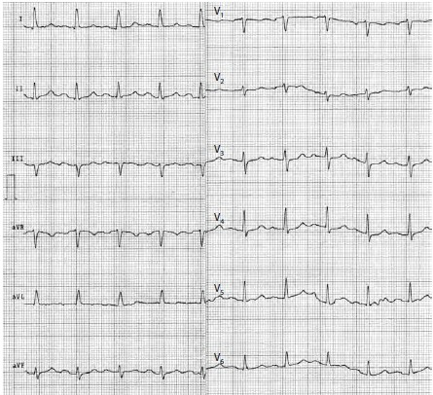
Normal ECG

Slide 15
Normal ECG Report
Normal intervals
The recording of an ECG on standard paper allows the time taken for the various phases of electrical depolarisation to be measured, usually in milliseconds. There is a recognized normal range for such ‘intervals’:
PR interval (measured from the beginning of the P wave to the first deflection of the QRS complex). Normal range 120 – 200 ms (3 – 5 small squares on ECG paper).
QRS duration (measured from first deflection of QRS complex to end of QRS complex at isoelectric line). Normal range up to 120 ms (3 small squares on ECG paper).
QT interval (measured from first deflection of QRS complex to end of T wave at isoelectric line). Normal range up to 440 ms (though varies with heart rate and may be slightly longer in females)
Heart rate estimation from the ECG
Standard ECG paper allows an approximate estimation of the heart rate (HR) from an ECG recording. Each second of time is represented by 250 mm (5 large squares) along the horizontal axis. So if the number of large squares between each QRS complex is:
5 - the HR is 60 beats per minute.
3 - the HR is 100 per minute.
2 - the HR is 150 per minute

